Slide 1

Research Project
Assessing the Impact of Energy Poverty on Human Development: A State-Level Analysis

Slide 2
Introduction and Background
India has increasing energy demands, aligned with the 2030 Agenda for Sustainable Development, which includes SDG 7—ensuring affordable, reliable, sustainable, and modern energy for all (United Nations, 2015).
India’s current Human Development Index (HDI) stands at 0.644 (UNDP, 2023).
Energy Requirement for Development: To reach an HDI of 0.9, the estimated per capita final energy requirement for India is 45.7 to 75 gigajoules per year (Bhattacharyya et al., 2022).
Current Energy Consumption: India’s per capita final energy consumption in FY23 was 16.7 gigajoules, indicating a significant gap between actual and required energy consumption for achieving Viksit Bharat (MoSPI, 2024).

Slide 3
OBJECTIVES
Construct a Multidimensional Energy Poverty Index (MEPI) at the state level using NFHS-3, NFHS-4 and NFHS-5 data to assess energy poverty across Indian states.
Examine the relationship between MEPI and HDI components (Education, life expectancy, and per capita income) at the state level.
OBJECTIVES
Identify state-level variations in energy poverty and human development, capture lagging regions and suggesting interventions to address these disparities.
To contextualize the findings with SDG7 goals, exploring reductions in energy poverty are aligned with India’s sustainable development objectives.

Slide 4



Data Sources
Dataset: Panel data covering multiple states over several years.
Key Variables:
Dependent Variable: Human Development Index (HDI)
Independent Variable: Multidimensional Energy Poverty Index (MEPI)
Control Variables: Year fixed effects to account for time trends.
Social Factors:
Sanitation Access (%)
Health Coverage (%)
Total Fertility Rate
Drinking Water Source (%)
NFHS-3 (2005-06), NFHS-4 (2015-16) and NFHS-5 (2019-21): Household data on electricity access, primary cooking fuel, used for constructing MEPI.

Slide 5
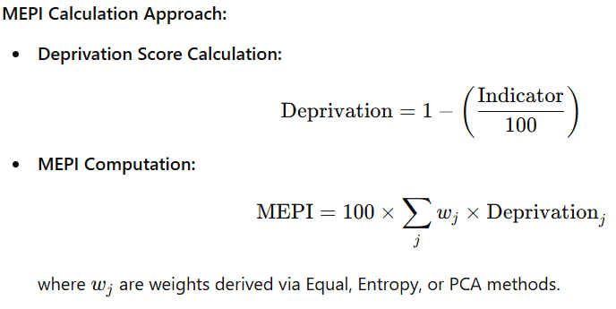
MEPI CONSTRUCTION
Develop a Multidimensional Energy Poverty Index (MEPI) to compare energy poverty across Indian states over time using NFHS data.
Access to Electricity (%)
Access to Clean Cooking Fuel (%)
Women having a bank or savings account (%)
Weighting Methods Considered:
Equal Weighting: All indicators contribute equally.
Entropy Weighting: Assigns higher weight to indicators with greater variability.
PCA Weighting: Uses the first principal component to capture joint variability—results in a more balanced weighting scheme.
Variables | MEPI PCA | MEPI Equal | MEPI Entropy
Dep_Households with electricity (%) | 0.218 | 0.333 | 0.756
Dep_Households using clean fuel for cooking (%) | 0.327 | 0.333 | 0.088
Dep_Women having a bank or savings account that they themselves use (%) | 0.455 | 0.333 | 0.157

Slide 6
Top 5 States based on HDI
Bottom 5 States based on HDI
State | HDI | MEPI PCA | HDI Rank | MEPI Rank
Punjab | 71.90 | 0.351 | 1 | 7
Kerala | 68.93 | 0.351 | 2 | 8
Mizoram | 68.13 | 0.336 | 3 | 5
Himachal Pradesh | 67.17 | 0.398 | 4 | 12
Haryana | 66.53 | 0.430 | 5 | 14
State | HDI | MEPI PCA | HDI Rank | MEPI Rank
Uttar Pradesh | 42.90 | 0.526 | 25 | 25
Odisha | 40.33 | 0.534 | 26 | 27
Assam | 39.80 | 0.545 | 27 | 28
Jharkhand | 38.70 | 0.514 | 28 | 22
Bihar | 34.43 | 0.627 | 29 | 29

Slide 7
Top 10 States with Highest HDI Growth
Bottom 10 States with Lowest HDI Growth
State | HDI Growth | MEPI Growth
Goa | 90.1 | -58.8
Odisha | 55.3 | -41.5
Bihar | 48.7 | -37.2
Chhattisgarh | 44.1 | -36.2
Madhya Pradesh | 42.1 | -45.7
Rajasthan | 40.5 | -37.9
Uttar Pradesh | 39.3 | -38.7
Assam | 38.8 | -37.7
Andhra Pradesh | 36.6 | -50.1
Jharkhand | 35.6 | -50.3
State | HDI Growth | MEPI Growth
Haryana | 25.0 | -39.5
Maharashtra | 24.6 | -19.4
Uttarakhand | 23.9 | -39.5
Himachal Pradesh | 21.1 | -34.2
Mizoram | 21.1 | -48.5
Sikkim | 21.0 | -43.6
Kerala | 20.1 | -42.1
Gujarat | 19.1 | -34.6
Telangana | 17.9 | -58.0
Punjab | 17.5 | -47.9

Slide 8
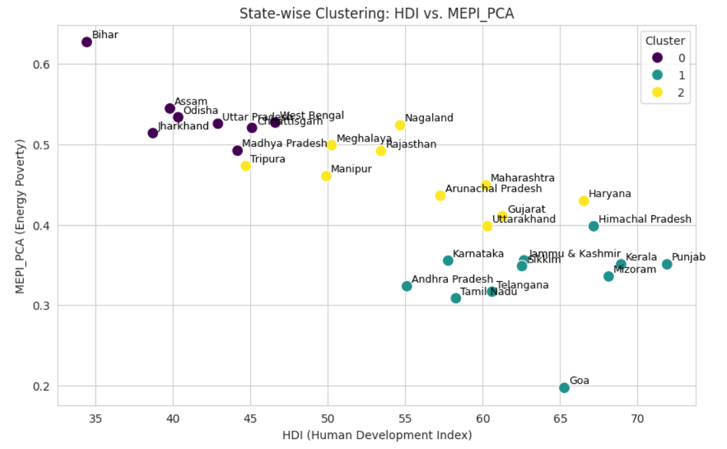
Clustering Analysis
Cluster 0 (High MEPI, Low HDI) → States with high energy poverty (MEPI), lower HDI, and poorer living conditions
Examples: Bihar, Odisha, UP, Assam
Cluster 1 (Low MEPI, High HDI) → Developed states with lower energy poverty and better human development
Examples: Kerala, Himachal Pradesh, Goa
Cluster 2 (Intermediate Group) → Moderate development, mixed energy access levels
Examples: Rajasthan, Gujarat, Maharashtra

Slide 9
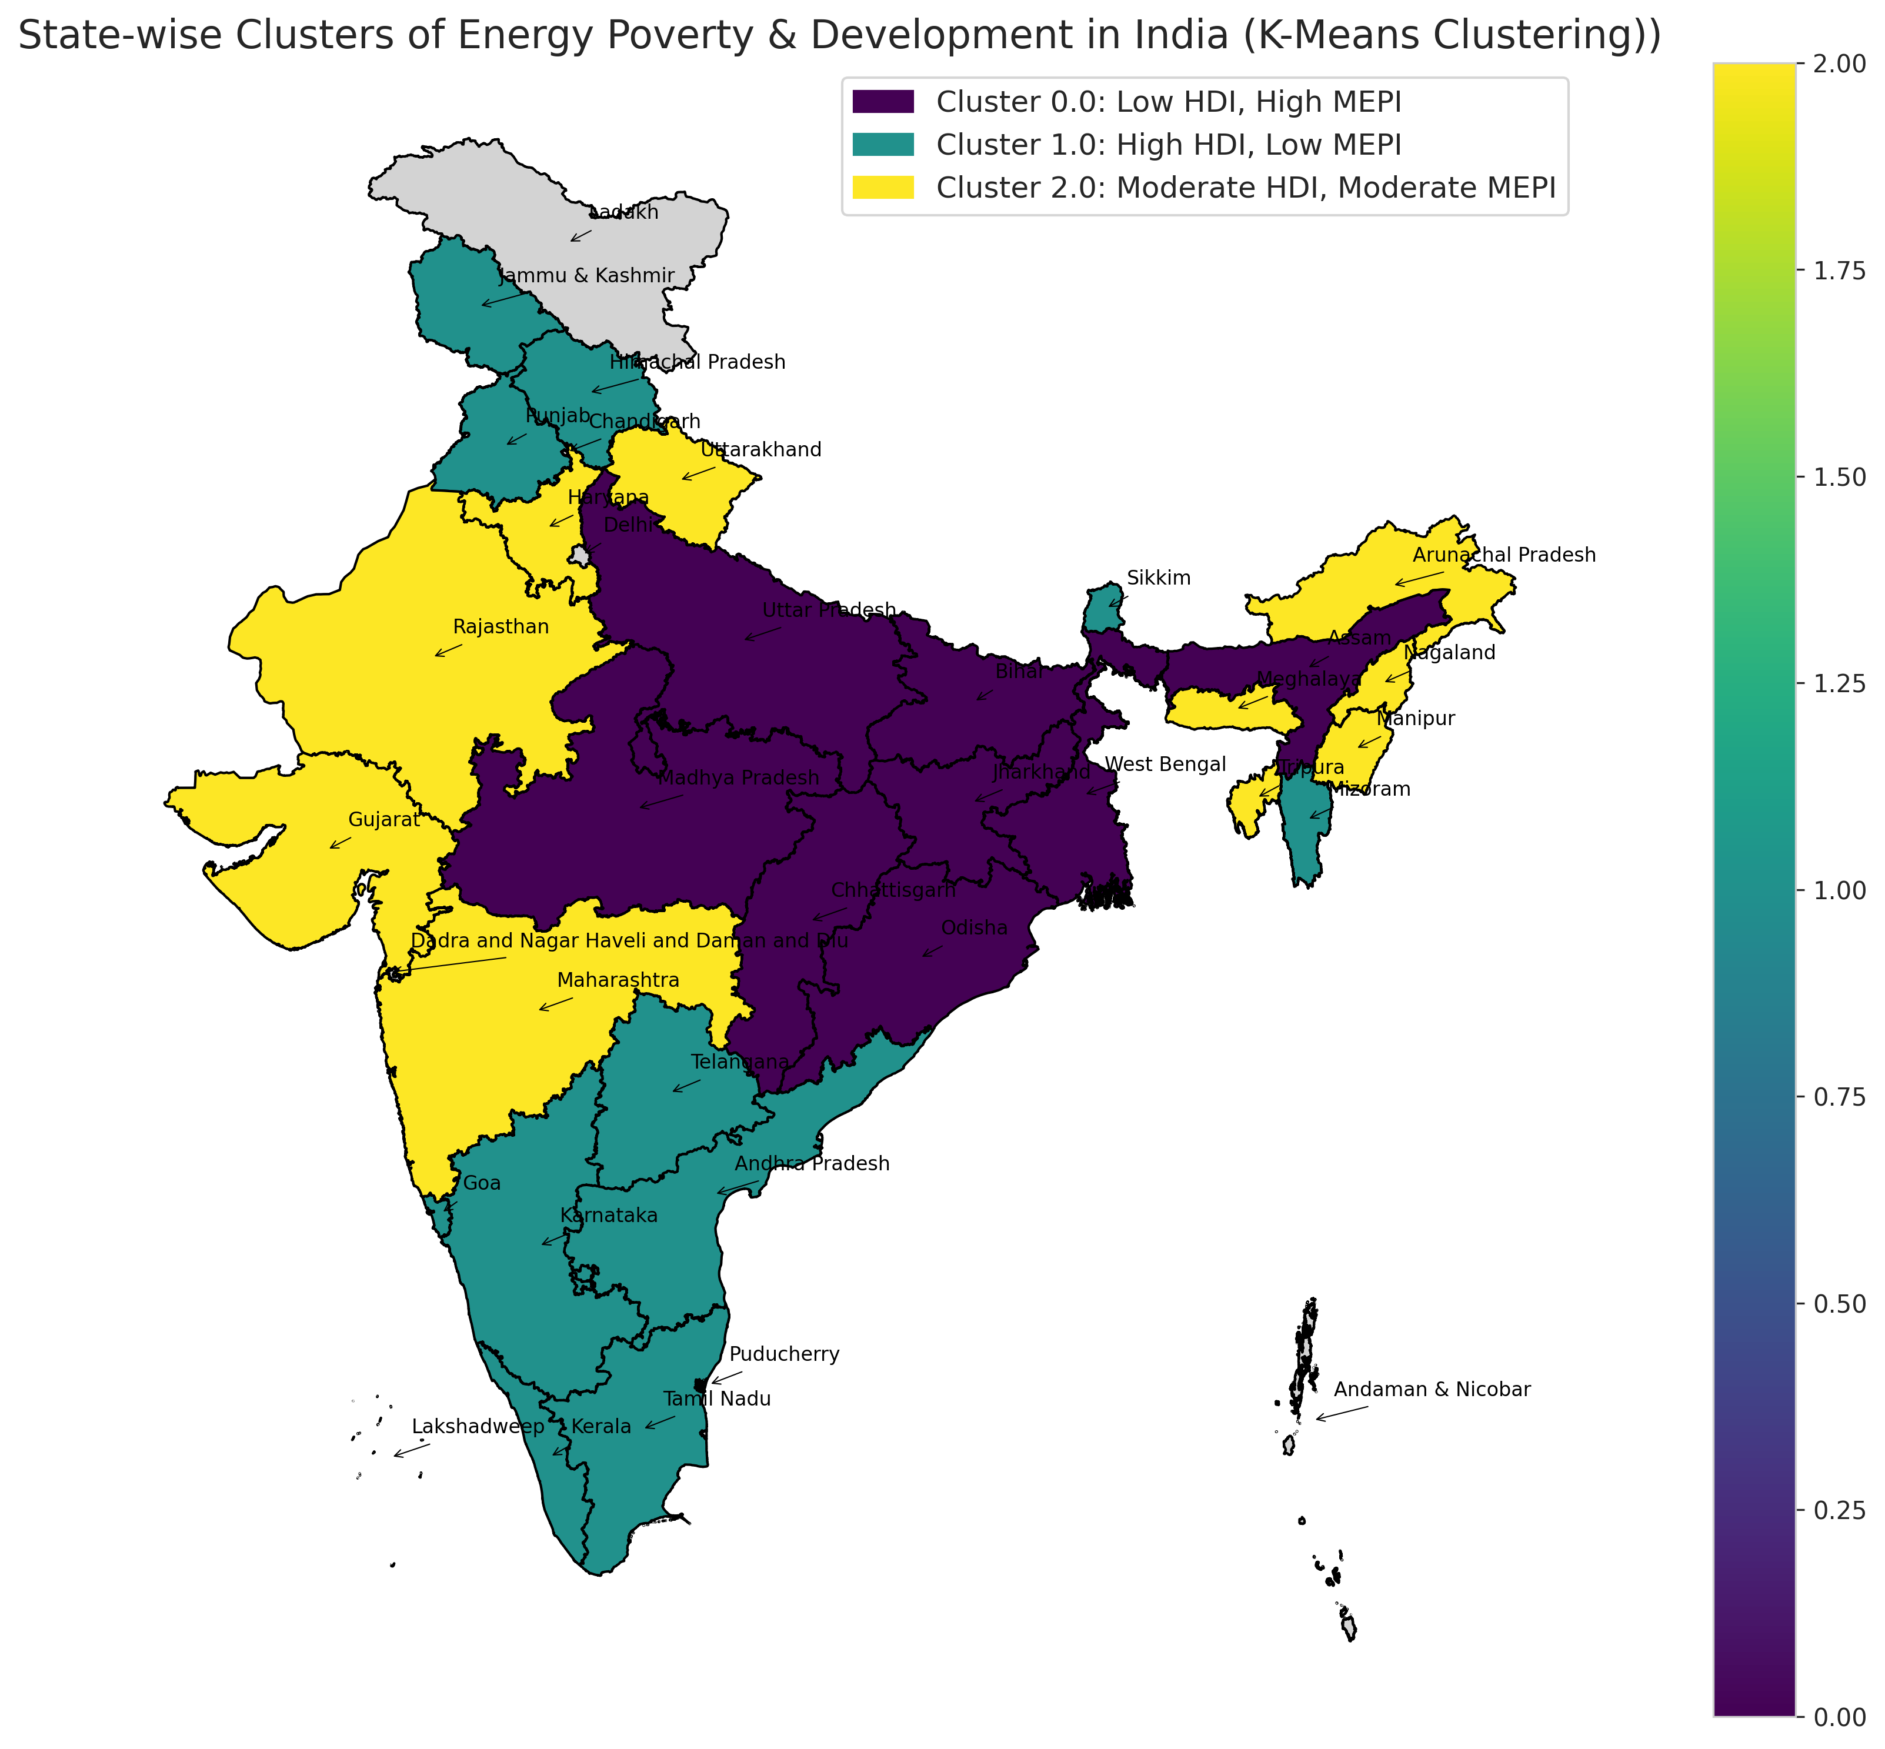

Slide 10
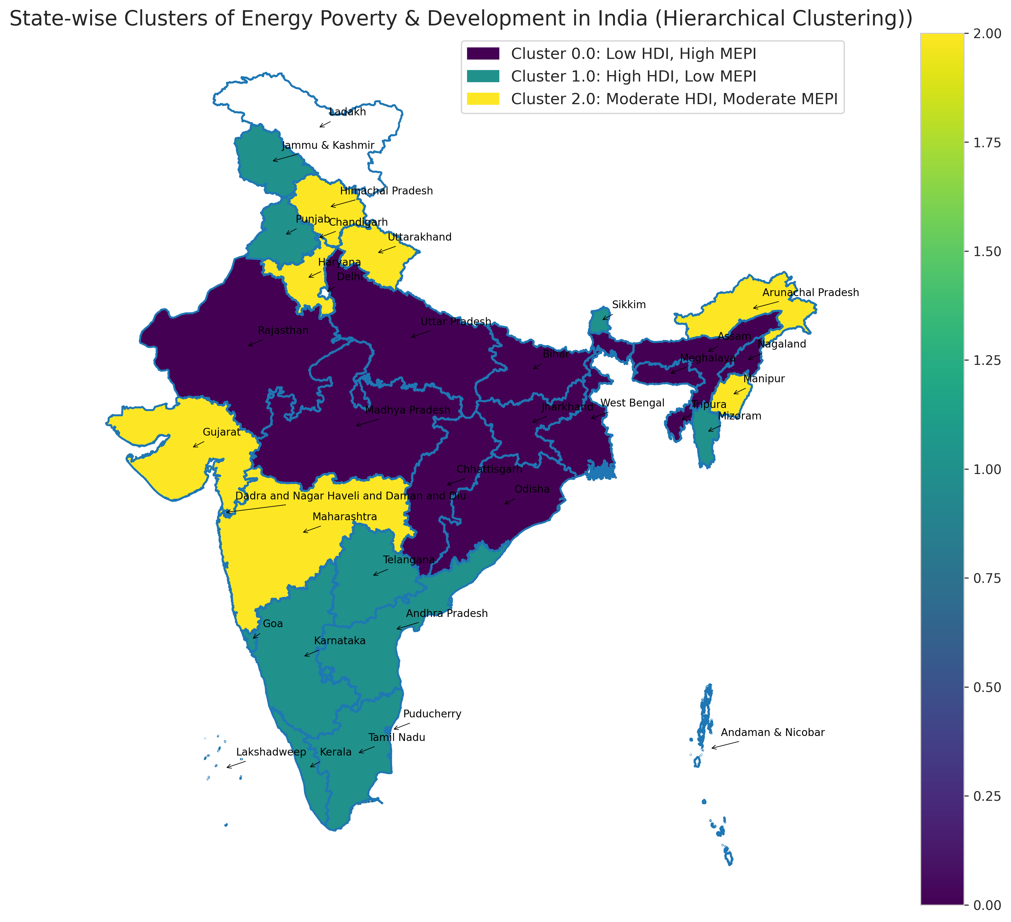

Slide 11
Regression Results
How Does Energy Poverty Affect Human Development?
Variable | Coefficient (β) | Std. Error | t-value | p-value
MEPI_PCA | -0.7811 | 0.1990 | -3.92 | 0.001
Year × MEPI_PCA (2015) | 0.2846 | 0.0802 | 3.55 | 0.001
Year × MEPI_PCA (2020) | 0.4273 | 0.2591 | 1.65 | 0.110
Sanitation_Improved | 0.0027 | 0.0010 | 2.79 | 0.009
Intercept (β0) | 4.0711 | 0.1403 | 29.01 | 0.000
Key Findings:
MEPI coefficient = –0.782 → A 0.1 unit increase in energy poverty leads to a 7.8% drop in HDI, on average
R² (Within): 0.748 → Model explains ~75% of variation in HDI
Controls: State-specific effects (culture, governance), and Time effects (policy, shocks)
The MEPI coefficient is statistically significant at 1% level, confirming robustness.
A high MEPI (more deprivation) corresponds with notable decline in human development.
Fixed Effects control for unobserved state-level factors like governance, infrastructure, or geography.

Slide 12
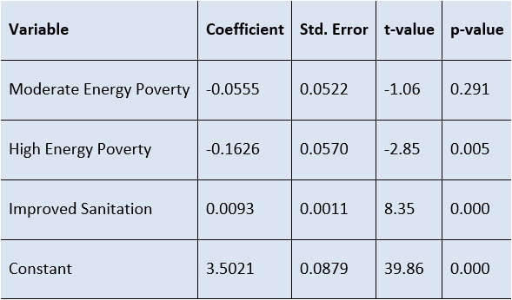
Clustering Data Model
High energy poverty is significantly associated with lower HDI (p = 0.005). The coefficient of -0.1626 suggests that states in high energy poverty have 16.26% lower HDI compared to the reference group (low energy poverty), holding other factors constant.
Moderate energy poverty is not statistically significant (p = 0.291), implying that HDI differences between moderate and low energy poverty states are less pronounced.
Access to improved sanitation has a positive and highly significant impact on HDI (p = 0.000), reinforcing the role of basic infrastructure in human development.
Why this matters:
Temporal interaction confirms that 2015 was a turning point, likely due to Ujjwala, Saubhagya, and energy schemes.
Clustering reinforces the finding: even after grouping states by similarity, MEPI remains a critical factor.
Takeaway:
“Energy poverty’s effect is persistent, but policy has the power to mitigate it. Targeted efforts post-2015 show measurable improvement.”

Slide 13
Conclusion
MEPI (Multidimensional Energy Poverty Index) is a strong negative predictor of Human Development Index (HDI).
A 0.1 increase in MEPI leads to an average 7.8% drop in HDI.
The impact weakens in 2015, indicating a temporal shift, possibly due to energy access schemes like Saubhagya or Ujjwala Yojana.
State-level fixed effects controlled for unobserved traits like governance, geography—giving a more accurate causal picture.
Regression results are robust across models, even when controlling for clustering and temporal dynamics.
"Energy poverty isn't just about power cuts — it's a structural barrier to human development."

Slide 14
Targeted Policy Recommendations
Expand Solar Microgrids in rural areas of Cluster 2 states (e.g., Bihar, Odisha) with high MEPI.
Subsidize clean cooking fuels and LPG kits in households with high indoor pollution exposure.
Enhance mobile-based financial tools for energy purchases, credits, and government disbursals.
Design state-specific energy inclusion plans using MEPI-HDI cluster maps.
Integrate MEPI into SDG dashboards to track progress in real-time and inform mid-course corrections.
These policy moves align with SDG 7 and accelerate India’s Viksit Bharat goal.

Slide 15
Future Scope
Household-level econometric modeling using IHDS or NSSO data for micro-targeted policies.
Apply Instrumental Variable (IV) methods to tackle endogeneity and establish causal links.
Extend MEPI to measure energy inequality across gender, income groups, and rural–urban divides.
Integrate findings with SDGs beyond SDG 7, especially in education, health, and gender equality.
This research lays the foundation — deeper work can shape real-time, data-driven policy.

Slide 16

Thank you!
“Grateful to mentors, faculty, and peers who supported this research journey.”
Contact Info:
LinkedIn
GitHub
Website
Thank you for reviewing my research! I look forward to applying these insights in analytics, energy, and policy roles.

